Slide 1




Research Presentation Presented by: Joseph Chorbajian, Aniruddha Gawande, Abhishek Jajoo, Satyam Sharma, Ishan Unnarkar Group 4
“Robust and Sparse Linear Discriminant Analysis via an Alternating Direction Method of Multipliers”
by Chun-Na Li, Yuan-Hai Shao, Wotao Yin, and Ming-Zeng Liu
Notes:
I. Introduction
- Overview of the problem being studied
- Importance of solving the problem
II. Limitations of Classical LDA
- LDA's susceptibility to polluted data
- The SSS problem in L2-norm-based LDA
III. Robust and Sparse Linear Discriminant Analysis
- Explanation of the proposed method
- Benefits of the method over classical LDA
IV. Alternating Direction Method of Multipliers (ADMM)
- Overview of ADMM
- How ADMM is applied to the proposed method
V. Experimental Results
- Description of the experiments conducted
- Comparison of the proposed method to other methods
- Discussion of the results
VI. Conclusion
- Summary of the paper's contributions
- Future work and potential areas for improvement

Slide 2
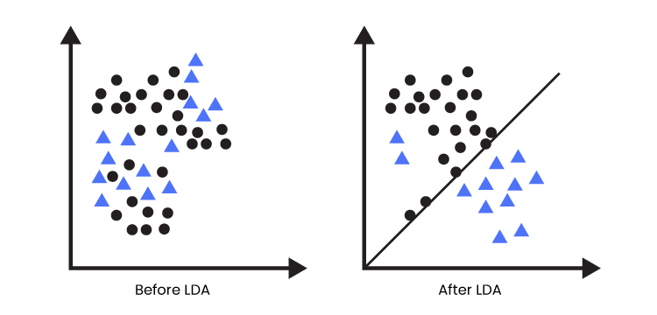
Introduction
Linear Discriminant Analysis (LDA) is a linear classification method used to separate two or more classes of objects or events by projecting them onto a lower-dimensional space.
LDA focuses on separability

Slide 3
Overview of the problem being studied
LDA methods can produce a large number of features, which can lead to overfitting and poor generalization to new data.
LDA methods can be sensitive to outliers, which can adversely affect the classification accuracy.
LDA methods assume that the covariance matrix is the same for all classes, which may not be true in practice and can lead to poor classification accuracy.

Slide 4
Importance of solving the problem
LDA is sensitive to outliers which can result in misclassification and poor accuracy.
Overfitting can result in poor generalization to new data.
Covariance matrix assumptions may not be valid in many real-world problems.
When projection vectors drift far from their desired directions they result in poor classification accuracy and reduced usefulness of the model for real-world problems.

Slide 5
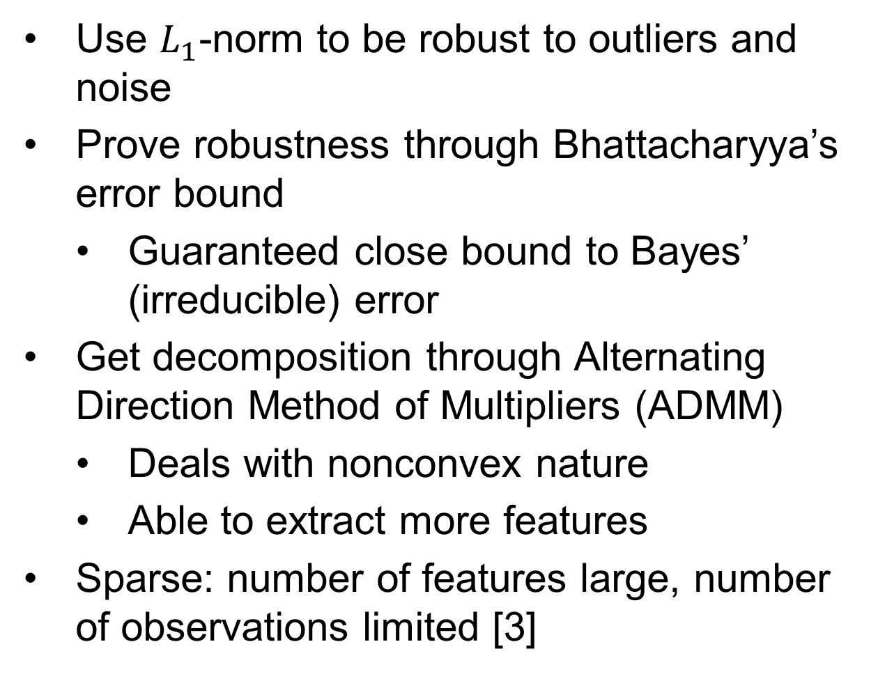
Robust LDA
Use $L_{1}$-norm to be robust to outliers and noise
Prove robustness through Bhattacharyya’s error bound
Guaranteed close bound to Bayes’ (irreducible) error
Get decomposition through Alternating Direction Method of Multipliers (ADMM)
Deals with nonconvex nature
Able to extract more features
Sparse: number of features large, number of observations limited [3]
Notes:
Let’s talk about the paper’s contribution. We know that L1-norm provides more robustness to outliers and noise, but how? We can use Bhattacharyya’s error bound, a measure of how similar two distributions are. The two distributions we compare are the data and its dimensionally-reduced projection. Minimizing this error is essential in getting accurate reductions. Thankfully, the authors proved that it’s a close bound to Bayes’ irreducible error.
For dimensional reduction to happen, we need a way to get the most important features. Typically, you would use eigendecomposition, but we use an Alternating Direction Method of Multipliers instead for L1-norm. Not only can it work with the nonconvex nature of LDA, it also doesn’t have the same restriction where the number of features must be one less than the number of classes.
A variant of RLDA, Sparse RLDA, can work with fewer observations and extract more features.

Slide 6
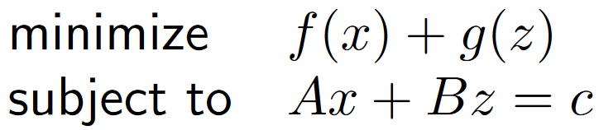
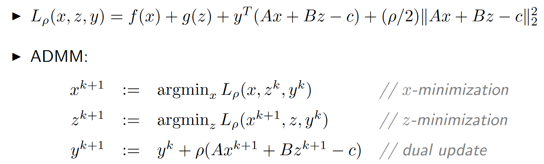
Alternating Direction Method of Multipliers
Rewrite the minimization to the form
Add penalty
We know how to minimize efficiently
Figure 1. [2]
Figure 2. Augmented Lagrangian and minimization of two variables [2]
Notes:
Alternating Direction Method of Multipliers is unique in how it optimizes. Instead of minimizing any generic function with one variable, it minimizes the sum of two functions with different variables.
If we add a penalty to the sum, then we create an augmented Lagrangian. This helps us because other researchers found an efficient way to minimize both variables at the same time within one iteration. Finding the arguments of the minima for both variables can also be done in parallel, speeding up computation.

Slide 7
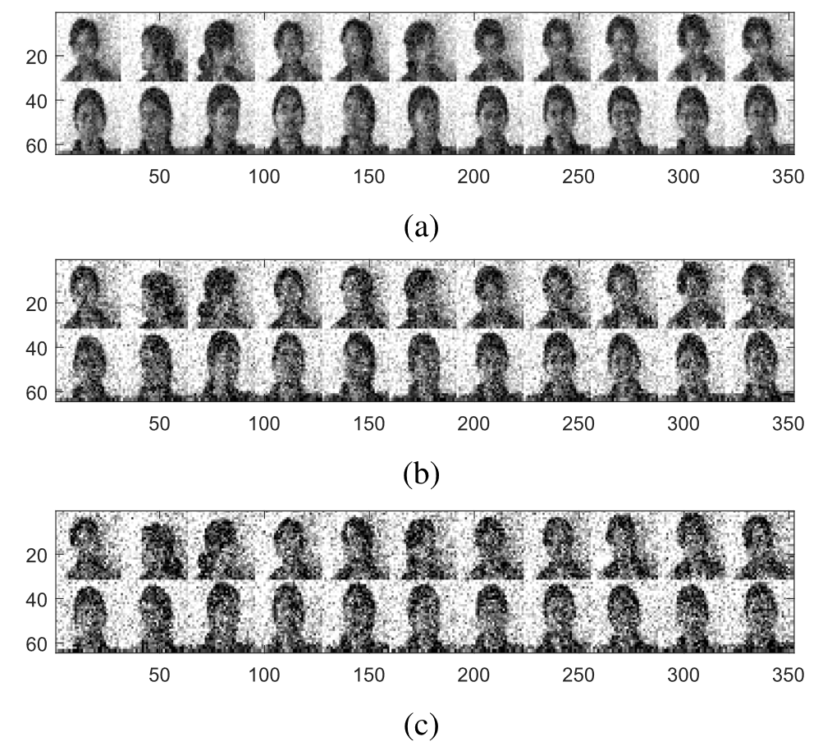
Methodology
Compare multiple dimensionality reducing algorithms
Use artificial and real datasets
Measure accuracy and time
Figure 3. Samples of the noisy female Indian dataset [1]
Notes:
In order to test whether their Robust LDA has real improvement, the authors decided to test it against both artificial and real datasets. Here, they compare it against PCA, Principal Component Analysis, PCA with L1-norm, LDA, regularlized LDA, LDA with L1-norm, and other methods.
For their datasets, they created two datasets with 2 dimensions, with both dimensions being normally distributed with different parameters. Each dataset has 50 samples, but one dataset has one outlier and the other has two outliers. For the real dataset, they used the images of Indian female faces, with each image being 32x32 pixels and 8-bit grayscale. To test robustness, they add normally distributed noise to each image.

Slide 8
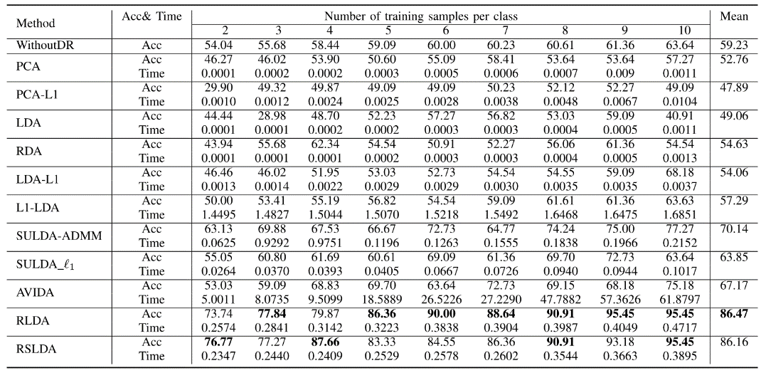
Experimental Results - I
RLDA and RSLDA are new LDA (Linear Discriminant Analysis) methods that are more reliable and sparser.
They use negative formulations, avoiding the use of L1-norm to solve complex optimization problems.
This allows for the selection of the right regularization term.
The proposed approaches can ensure optimal answers since the RSLDA method combines robustness and sparsity.
Figure 4. Table of results. Bold values indicate best in column [1]

Slide 9
Experimental Results - II
Since the suggested RLDA approach leverages Bhattacharyya error bound optimization without this restriction, it is an improvement above L1-LDA.
The ADMM algorithm is employed to solve RLDA and RSLDA.
SULDA and its variants SULDA-ADMM and SULDA 1 seek sparse solutions but do not consider robustness.
RLDA and RSLDA utilize L1-norm to achieve robustness and sparseness, and they are an improvement over SULDA in terms of both these aspects.

Slide 10
Conclusion
The paper proposes a robust and sparse linear discriminant analysis (RSDA) method via an alternating direction method of multipliers (ADMM).
RSDA is able to handle both outliers and noise in the data.
RSDA is also able to find a sparse set of discriminant features.
Experimental results show that RSDA outperforms other state-of-the-art methods on both synthetic and real-world data sets.
Notes:
In order to test whether their Robust LDA has real improvement, the authors decided to test it against both artificial and real datasets. Here, they compare it against PCA, Principal Component Analysis, PCA with L1-norm, LDA, regularlized LDA, LDA with L1-norm, and other methods.
For their datasets, they created two datasets with 2 dimensions, with both dimensions being normally distributed with different parameters. Each dataset has 50 samples, but one dataset has one outlier and the other has two outliers. For the real dataset, they used the images of Indian female faces, with each image being 32x32 pixels and 8-bit grayscale. To test robustness, they add normally distributed noise to each image.

Slide 11
Thank You!
Notes:
In order to test whether their Robust LDA has real improvement, the authors decided to test it against both artificial and real datasets. Here, they compare it against PCA, Principal Component Analysis, PCA with L1-norm, LDA, regularlized LDA, LDA with L1-norm, and other methods.
For their datasets, they created two datasets with 2 dimensions, with both dimensions being normally distributed with different parameters. Each dataset has 50 samples, but one dataset has one outlier and the other has two outliers. For the real dataset, they used the images of Indian female faces, with each image being 32x32 pixels and 8-bit grayscale. To test robustness, they add normally distributed noise to each image.

Slide 12
Citations
Conclusion
[1]: C. -N. Li, Y. -H. Shao, W. Yin and M. -Z. Liu, "Robust and Sparse Linear Discriminant Analysis via an Alternating Direction Method of Multipliers," in IEEE Transactions on Neural Networks and Learning Systems, vol. 31, no. 3, pp. 915-926, March 2020, doi: 10.1109/TNNLS.2019.2910991.
[2]: Distributed Optimization and Statistical Learning via the Alternating Direction Method of Multipliers (Boyd, Parikh, Chu, Peleato, Eckstein)
[3]: L. Clemmensen, T. Hastie, D. Witten, and B. Ersbøll, “Sparse discriminant analysis"
Notes:
In order to test whether their Robust LDA has real improvement, the authors decided to test it against both artificial and real datasets. Here, they compare it against PCA, Principal Component Analysis, PCA with L1-norm, LDA, regularlized LDA, LDA with L1-norm, and other methods.
For their datasets, they created two datasets with 2 dimensions, with both dimensions being normally distributed with different parameters. Each dataset has 50 samples, but one dataset has one outlier and the other has two outliers. For the real dataset, they used the images of Indian female faces, with each image being 32x32 pixels and 8-bit grayscale. To test robustness, they add normally distributed noise to each image.

